Slide 1

PYTHON 101
PYTHON BOOTCAMP

Slide 2
WHAT WE SHALL COVER
Week 1
The Basics
Week 2
Advanced Python Concepts
Week 3
Http Communication & Scripting

Slide 3
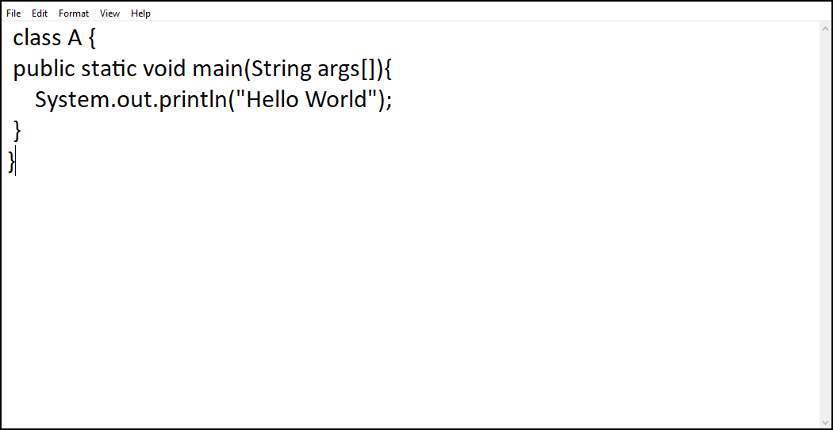
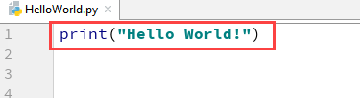
WHY PYTHON?
Hello World in Java
Hello World in Python

Slide 4
Why python?
Simplicity (Less boilerplate code)
High level language (No need to worry about memory allocation et al.)
Extensive Support Libraries (NumPy, Pandas)
Improved Programmer’s Productivity
User-friendly data structures
Object-oriented language
Dynamically Typed
Cross-Platform

Slide 5
Disadvantages of python
Dynamically-Typed leading to run-time errors
Speed Limitations
Weak Performance (in browser and mobile)
Underdeveloped Database Access layers compared to other languages
Simplicity (yes, this can also be a problem)

Slide 6
BASIC DATA TYPES And Structures
Strings
Numeric data types (Integer, Float, Complex Numbers)
Boolean
Lists
Tuples
Dictionaries

Slide 7
Numbers
An integer is any whole number (1, 2, 3)
Float contains a decimal point (1.234)
Complex numbers are a more of algebraic expressions (4y)

Slide 8
Number operations
Operator | Description | Example
+ (Addition) | Adds operands on either side of the operator. | >>> a=21 >>> b=10 >>> c=a+b >>> c 31
- (Subtraction) | Subtracts the right-hand operand from the left-hand operand. | >>> a=21 >>> b=10 >>> c=a-b >>> c -11
* (Multiplication) | Multiplies values on either side of the operator. | >>> a=21 >>> b=10 >>> c=a*b >>> c 210
/ (Division) | Divides the left-hand operand by the right-hand operand. | >>> a=21 >>> b=10 >>> c=a/b >>> c 2.1
% (Modulus) | Returns the remainder of the division of the left-hand operand by right-hand operand. | >>> a=21 >>> b=10 >>> c=a%b >>> c 1
** (Exponent) | Calculates the value of the left-operand raised to the right-operand. | >>> a=21 >>> b=10 >>> c=a**b >>> c 16679880978201
// (Floor Division) | The division of operands where the result is the quotient in which the digits after the decimal point are removed. But if one of the operands is negative, the result is floored, i.e., rounded away from zero (towards negative infinity): | >>> a=9 >>> b=2 >>> c=a//b >>> c 4

Slide 9
Arithmetic Operations on Complex Numbers
Addition and subtraction of complex numbers is straightforward. Real and imaginary parts are added/subtracted to get the result.
a=6+4j
b=3+2j
a+b
(9+6j)
a-b
(3+2j)

Slide 10
Strings
A string object is one of the sequence data types in Python. It is an immutable sequence of Unicode characters. Strings are objects of Python's built-in class 'str’.
Strings are declared as str1='hello’
To get the first letter of the above string, you can use str1[0], with the number being the position of the letter you want
To create a multiline string, you can use triple quotes

Slide 11
Lists
the list is a collection of items of different data types. It is an ordered sequence of items. A list object contains one or more items, not necessarily of the same type, which are separated by comma and enclosed in square brackets [].
An example list = [value1, value2, value3,...valueN]
To get an item in a list, you can use this syntax: list[0]

Slide 12
Tuple
Tuples are very similar to lists, except they are immutable. Once created you cannot change the contents
To create a tuple, tuple = (value1, value2, value3,...valueN)
It can also contain different data types

Slide 13
Dictionary
Like the list and the tuple, dictionary is also a collection type. However, it is not an ordered sequence, and it contains key-value pairs
To create one, dict = { key1:value1, key2:value2,...keyN:valueN }
To retrieve a value, dict.get(“key”)

Slide 14
While and for loops
Python uses the while and for keywords to constitute a conditional loop, by which repeated execution of a block of statements is done until a Boolean expression is true.
The for loop is used with sequence types such as list, tuple and set. The body of the for loop is executed for each member element in the sequence.

